Slide 1
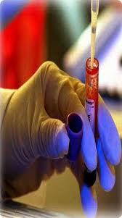
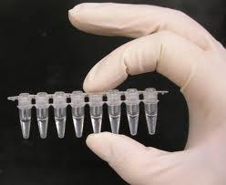
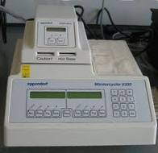
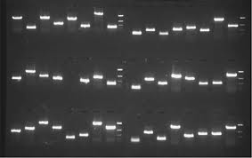
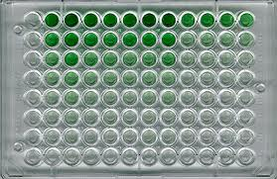
  Infectious Diseases
  Lesson 2.5

Slide 2
Lesson Objectives:
After finishing today’s lesson, you will be able to:
explain how the limitations of Koch’s postulates affect investigations into possible infectious diseases.
design an experiment to test the hypothesis that an infectious agent is the cause of a disease.
predict and interpret the experimental results relating to the hypothesis.

Slide 3
Do Now
What is a stomach ulcer?
Ulcers are non- to slow-healing erosions of epithelial lining!

Slide 4
Do Now
Discuss the results from your homework experiment.
What people are you going to include in the study?
How will the people be grouped and treated?
How are you going to measure changes in the ulcers?
What is your ‘control group’ and why do you need one?

Slide 5
Which graph most closely matches the results you predicted?
A
B
Number of ulcers
after 2 months
Number of ulcers
after 2 months
Control Experimental
Control Experimental
C
D
Number of ulcers
after 2 months
Number of ulcers
after 2 months
Control Experimental
Control Experimental

Slide 6
Discussion
What would you expect to see if stomach ulcers were caused by bacteria?
Where would you look for the bacteria?

Slide 7
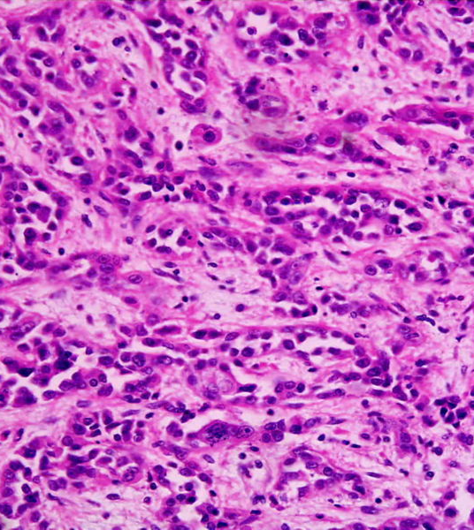
Dr. J. Robin Warren (pathologist)
Examined stomach biopsies of patients under the microscope. His patients had various stomach ailments.

Slide 8
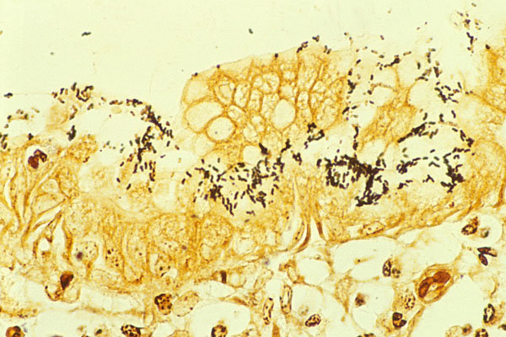
When he observed biopsy slides of patients with ulcers …
He noticed black spots of bacteria in the tissue.
It was a new species of bacteria later named Helicobacter pylori.
He thought the bacteria caused ulcers but his colleagues did not believe him!
Why?
Notes:
A: The pH of the stomach is too acidic for any bacteria to survive.
B: Seeing bacteria in ulcer biopsy samples was not reported as a routine finding.
C: Ulcers and stomach cancer are caused by age, stress and diet – bacteria have nothing to do with the problems the patients came to the hospital for.
D: He contaminated the samples with bacteria from the environment.

Slide 9
There are alternative explanations!
What might be some alternative explanations for why Dr. Warren was finding bacteria on his slides?

Slide 10

Dr. Barry J. Marshall joins
Dr. Warren’s research group
Hypothesis: Bacteria CAUSE stomach ulcers.
What would you do first to test the hypothesis?
Dr. Barry Marshall
Notes:
Look for an association!!

Slide 11
Their first survey study:
100 stomach ulcer patients surveyed (biopsy taken).
100% had H. pylori present.
Does this prove causation?
Unfortunately H. pylori does not cause disease in animal models. What can you do next?

Slide 12
Activity:
Possible second study
Design a experiment to test the hypothesis that H. pylori CAUSES stomach ulcers. In this study use antibiotics and sugar pills.
    In your design, focus on the following points:
    a. What people are you going to include in the study?
    b. How will the people be grouped and treated?
    c. How are you going to measure changes in the ulcers?
    d. What is your control group?

Slide 13
The doctors divided patients into two groups:
After 2 months, the number of ulcers per patient is assessed.
Predict what the results would look like if the bacteria theory was supported.
Group 1 received antibiotics and were instructed to take them 2x/day.
Group 2 received sugar pills (placebo) and were instructed to take them 2x/day.

Slide 14
2. Using the graph below, predict the results of your experiment.
Number of ulcers
after 2 months
Control Experimental

Slide 15
Which graph most closely matches the results you predicted?
A
B
Number of ulcers
after 2 months
Number of ulcers
after 2 months
Control Experimental
Control Experimental
C
D
Number of ulcers
after 2 months
Number of ulcers
after 2 months
Control Experimental
Control Experimental

Slide 16
Actual results of Warren & Marshall’s study
When treated with antibiotics, 80% of patients were permanently cured of their ulcers.
Do these results prove causation?

Slide 17
Do these results prove causation?
The ulcers could be caused by another bacteria - the antibiotics are not H. pylori specific!
The bacteria may propagate the ulcers but not cause them in the first place.
Which of Koch’s postulates was missing?
  They were not able to infect animals and that is why Dr. Marshall decided to do an additional test.

Slide 18

Drink It!
  Dr. Marshall drank a glass of H. pylori culture.
  He became ill with nausea and vomiting several days later.
  Ten days later an endoscopy revealed gastritis and H. pylori.

Slide 19
Wrap Up
Did Dr. Marshall prove causation?
Why or why not?

Slide 20
Homework
Study for quiz on Unit 2.

